Slide 1
Augmented Walking Suit with Pneumatic Gel Muscles
Wearable, Lightweight and Portable Assistive Suit for Augmenting Human Walking.

Slide 2
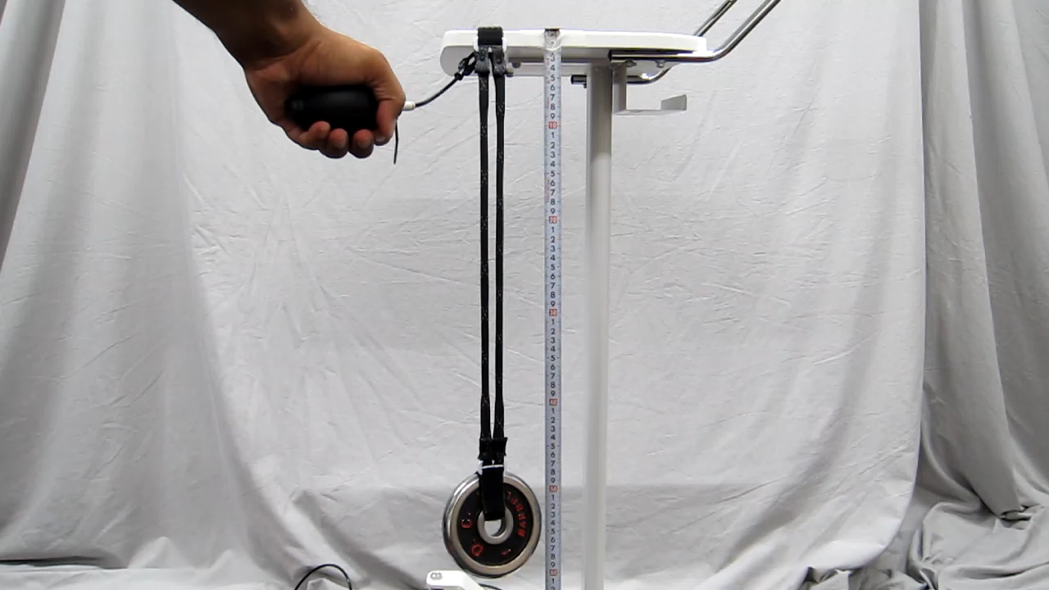
Pneumatic Gel Muscle
Pneumatic gel muscle can exert force with very low pressure e.g. commercial ball pump can generate 60 kPa air pressure which can exert force of 9.81 N and muscle length contracts by 7 cms

Slide 3
Augmented Walking Suit

Slide 4
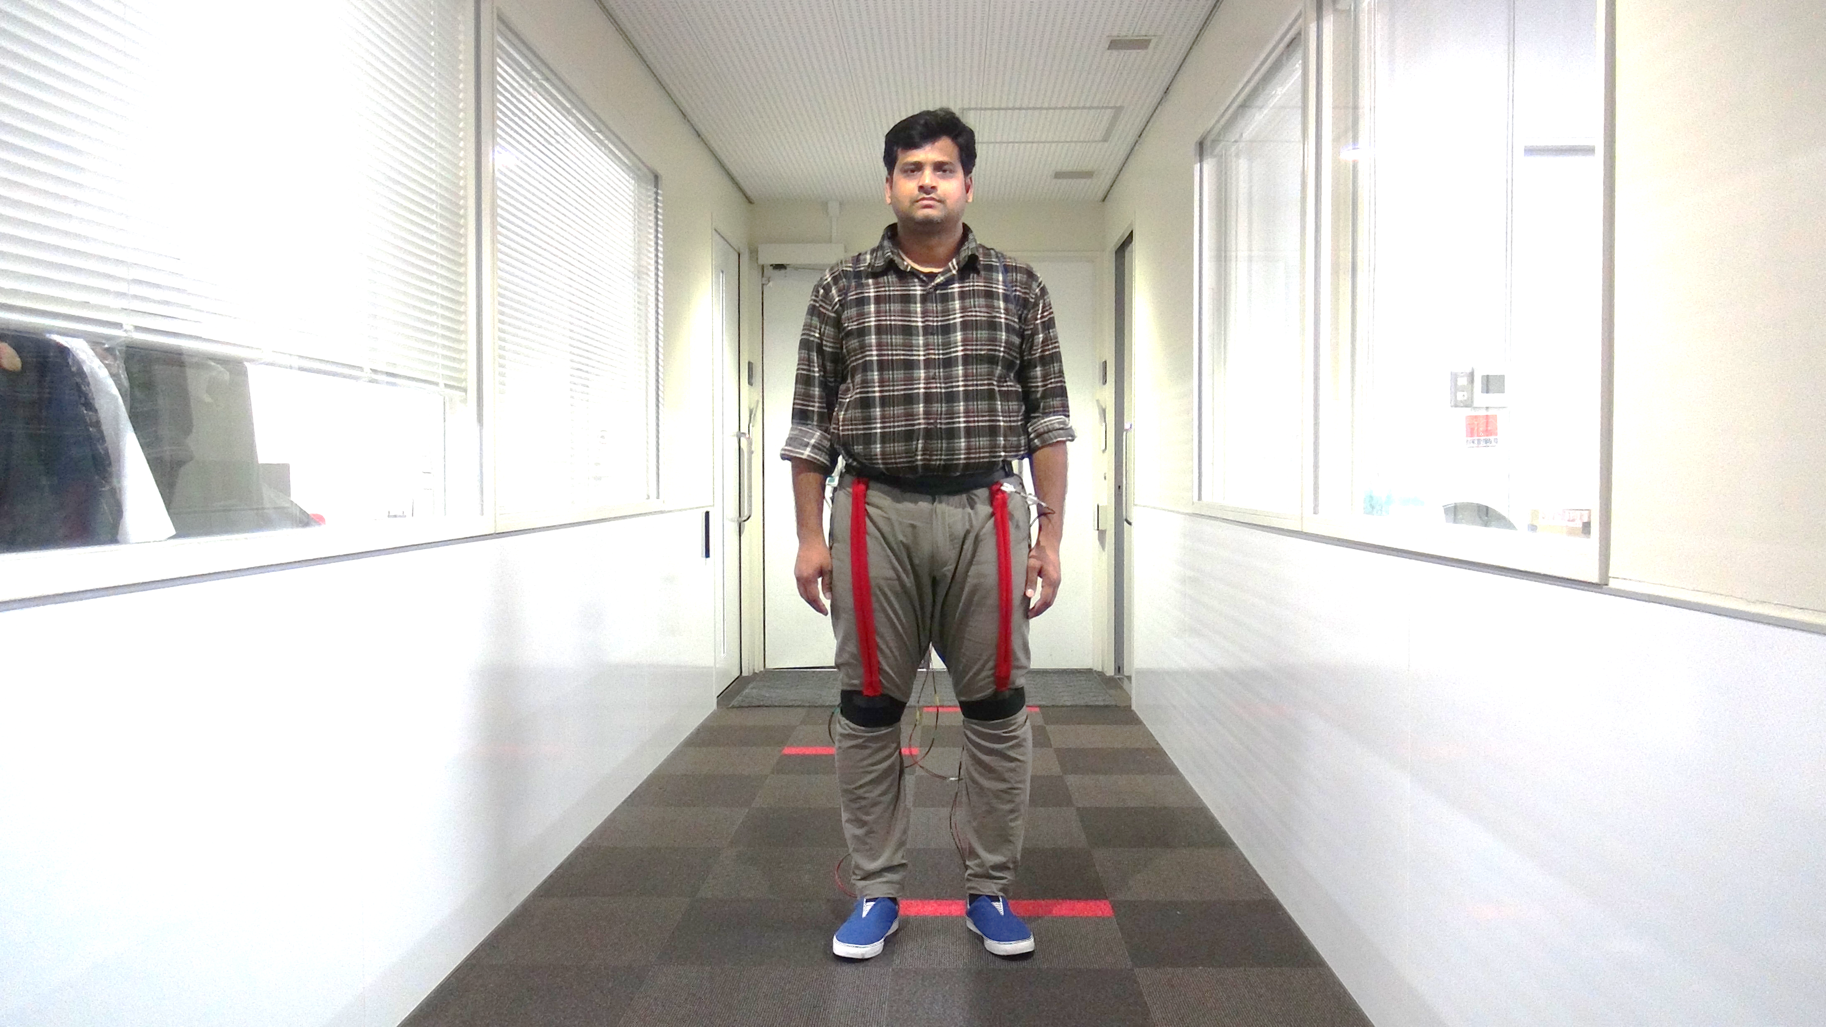
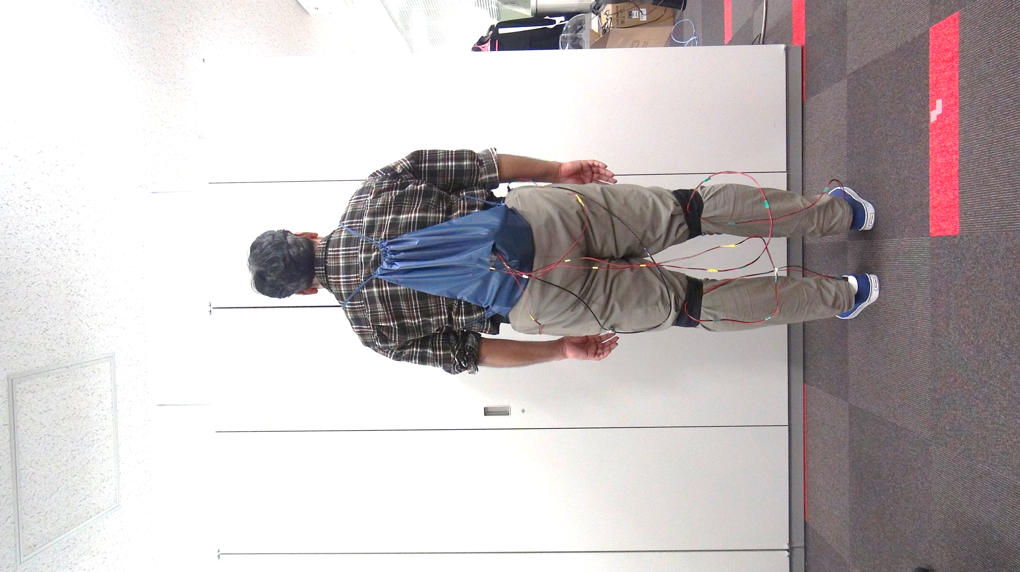
Control Box
Portable Battery
Air Tank
Pneumatic Gel Muscle
Solenoid Valve
Waist Support
Knee Support
FSR Sensor in shoe
Cables connection to control box

Slide 5
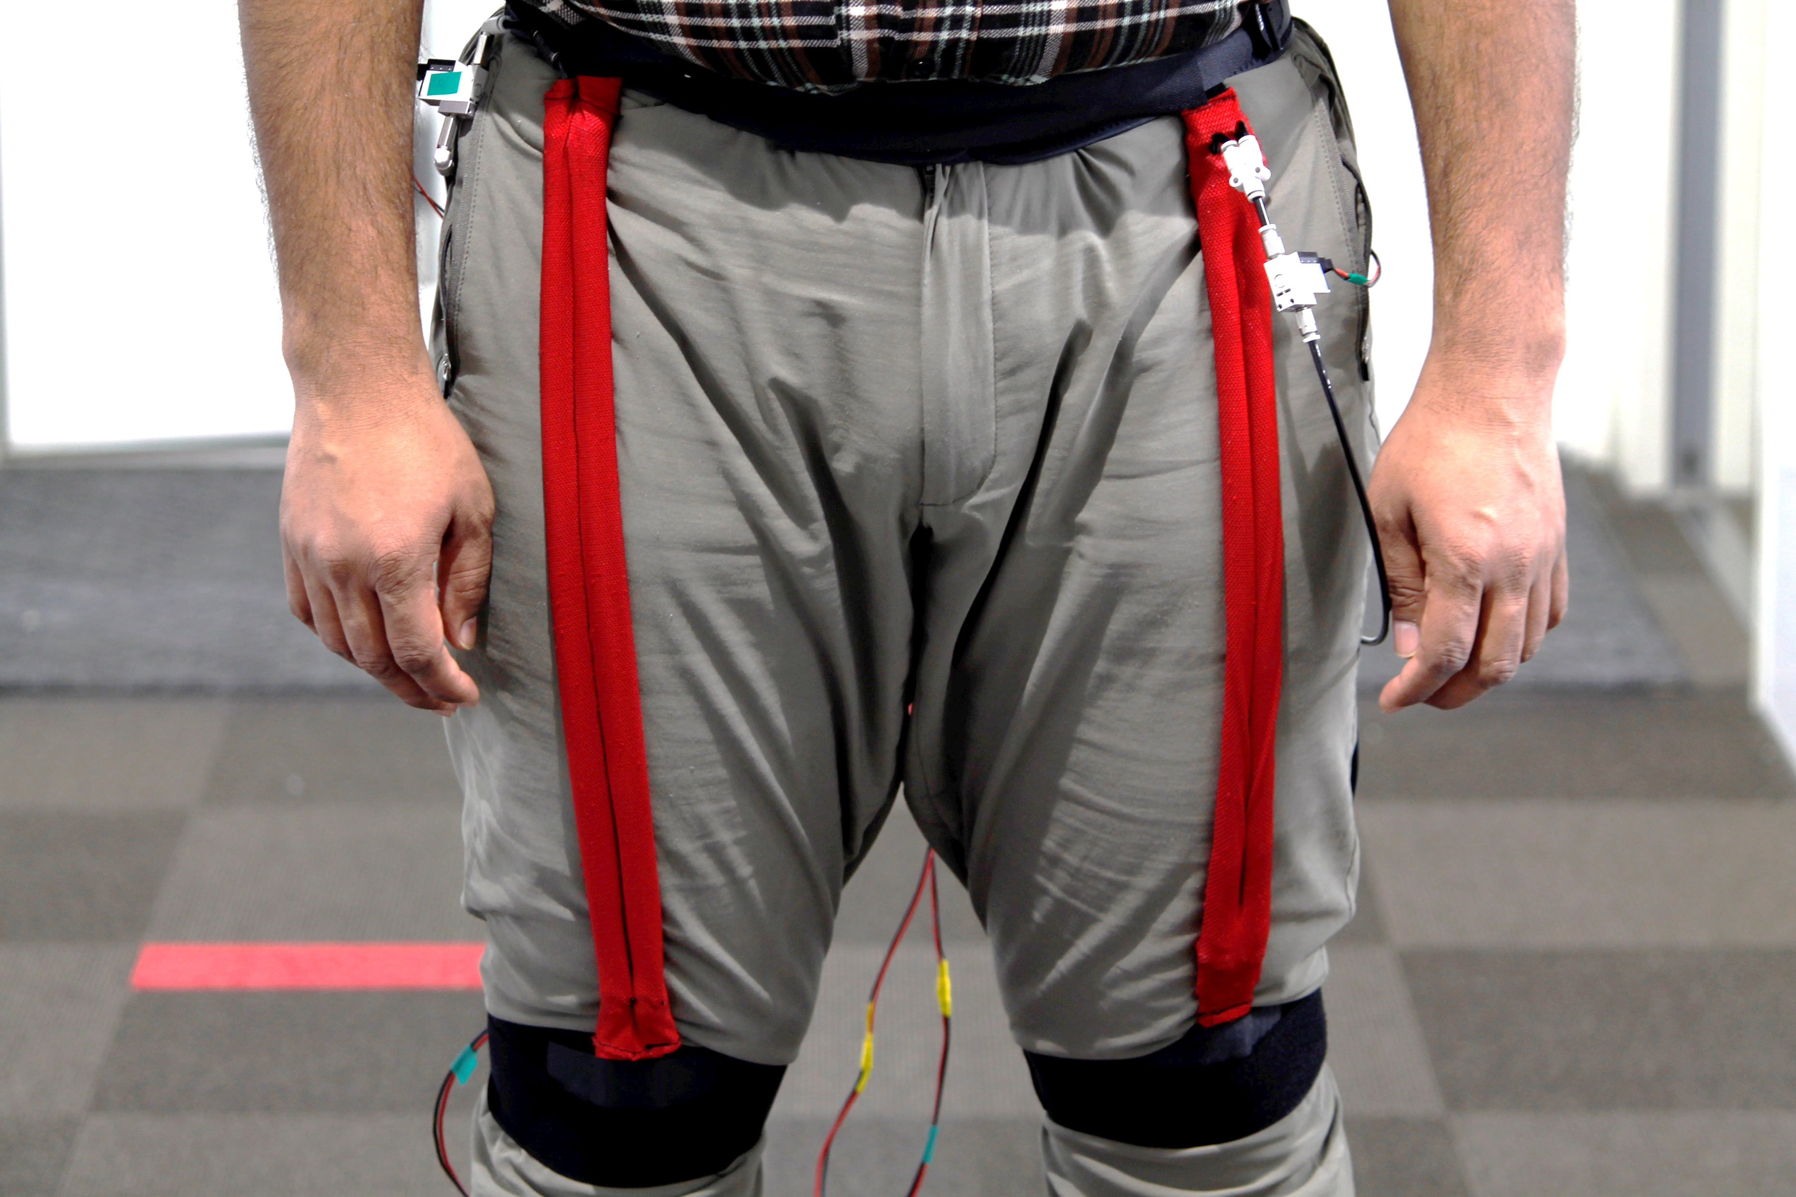
AWS Front & Close View

Slide 6
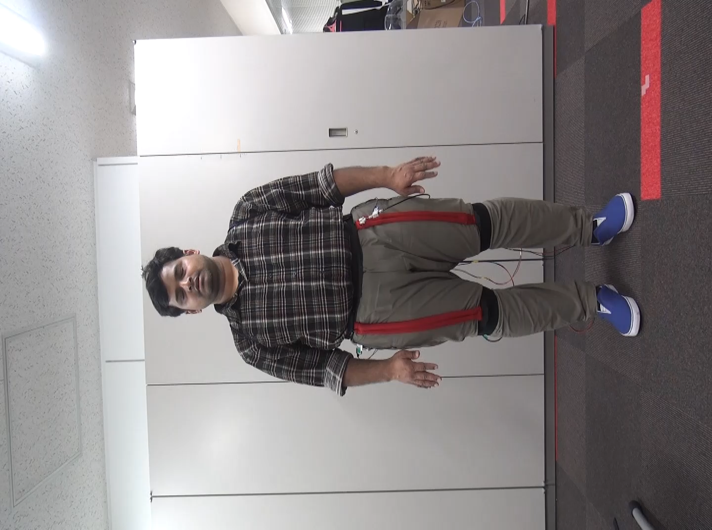
Control System Explained
No PGM actuation in standing position
Lifting the leg actuates the PGM thereby providing the assistive force.
Taking forward step assistive force is provided to the limb in the swing phase.

Slide 7
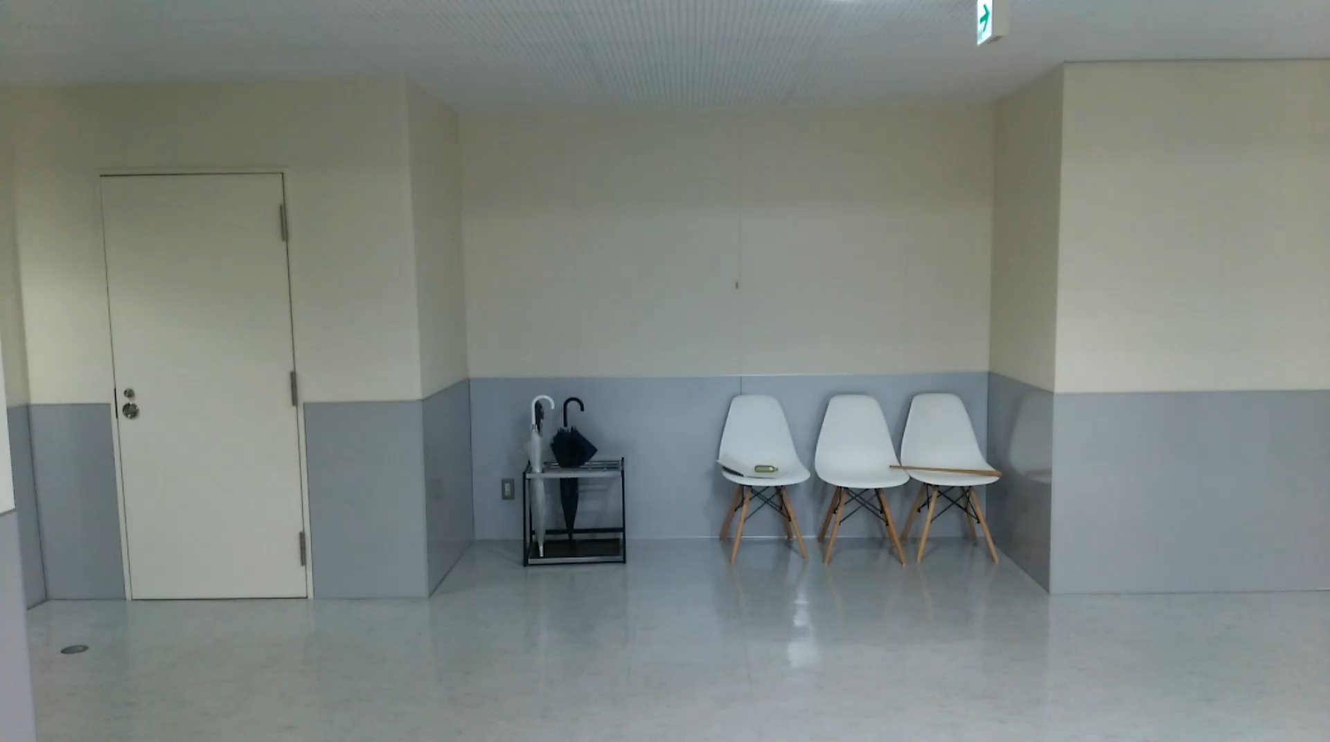
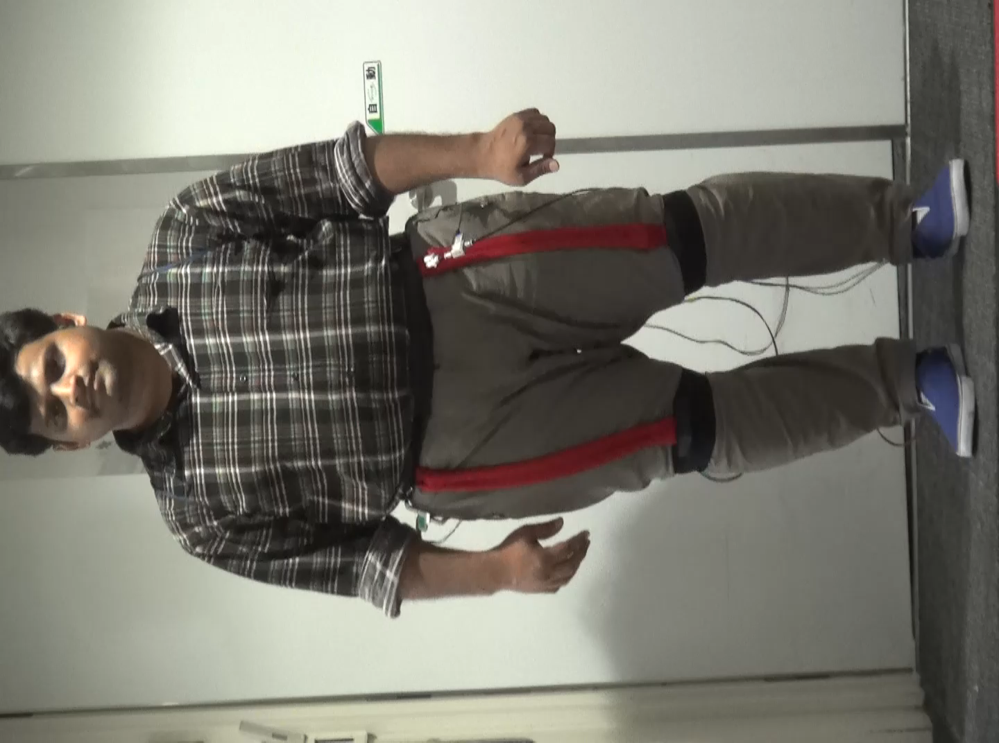
Walking Experiment
sEMG Recording Experiment

Slide 8
PGM Actuation in Swing Phase

